Slide 1


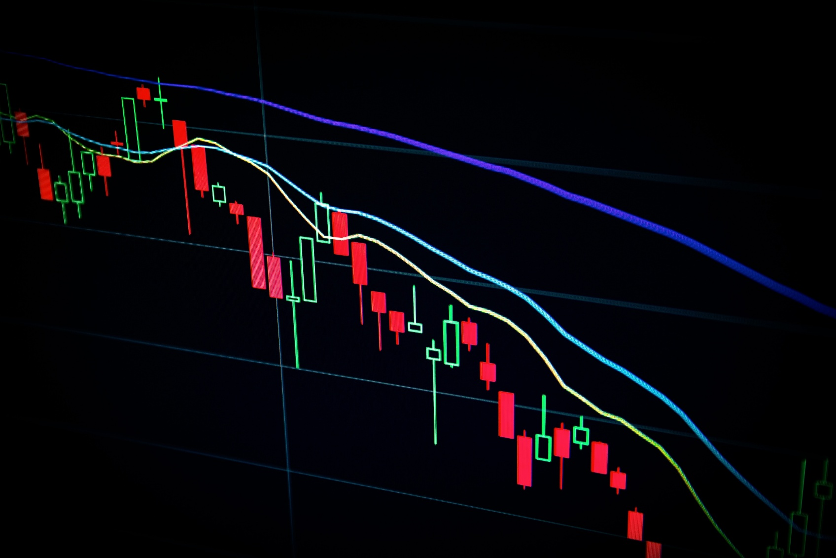


Artificial Intelligence IA2
Title: Stock prediction
16010122331 – Shubham Malgaonkar
16010122324 – Parth Sharma

Slide 2
Introduction
In the dynamic world of financial markets, accurately forecasting stock prices is crucial for making informed investment decisions. Traditional statistical models often struggle to capture the sequential dependencies and complex patterns in historical financial data.
This project investigates the use of Long Short-Term Memory (LSTM) neural networks—a type of Recurrent Neural Network (RNN)—for time series forecasting of stock prices. LSTMs are particularly well-suited for capturing long-term dependencies in sequential data, making them ideal for financial time-series prediction tasks.
The model was trained on historical stock data to learn patterns and trends, then evaluated for its predictive performance. Through this project, we aim not only to improve forecast accuracy but also to deepen our understanding of data preprocessing techniques, model tuning, and evaluation strategies specific to time-series problems.
This approach highlights the strength of LSTMs in financial forecasting and their potential role in real-world trading systems and investment strategies.

Slide 3

Yahoo Finance Dataset Overview
Collected using the Yahoo Finance API, this dataset contains detailed historical stock data for leading companies such as Apple (AAPL), Google (GOOGL), and others. Each record includes essential financial indicators like Open, High, Low, Close, and Volume, offering a comprehensive view of daily market behavior.
The dataset comprises approximately 2,500 daily entries per stock, spanning multiple years of trading activity. Each entry is structured with six key attributes:
Date ,Open, High, Low, Close, Volume
The target variable is the next day's closing price, making this dataset highly suitable for time-series forecasting tasks.
This structured and real-world financial dataset enables the development and evaluation of machine learning models, particularly those focused on sequential learning, such as LSTM. Its accessibility and alignment with real market data make it a valuable resource for both academic research and practical financial modeling.

Slide 4
Project Objectives
To Design and Implement a Time-Series Forecasting Model Using LSTM: Develop a robust Long Short-Term Memory (LSTM) network capable of capturing temporal dependencies and patterns in historical stock data for accurate next-day price prediction.
To Preprocess and Prepare Stock Market Data Effectively: Apply crucial preprocessing techniques such as scaling, normalization, and sequence generation to structure the data appropriately for time-series modeling and enhance learning efficiency.
To Train and Validate the LSTM Model: Utilize effective training strategies, including suitable loss functions, optimizers (e.g., Adam), and early stopping to ensure the model learns temporal patterns without overfitting.
To Evaluate Forecasting Accuracy Using Quantitative Metrics: Assess the predictive performance of the trained model using regression-based evaluation metrics like Mean Squared Error (MSE) and Root Mean Squared Error (RMSE) to quantify forecast reliability.
To Visualize and Interpret Model Predictions: Compare predicted vs. actual closing prices through line plots, and analyze trends, errors, and anomalies to understand the model's behavior and improve forecasting decisions.

Slide 5
Tools and Technologies Used
Layer | Technology
Language | Python
Libraries | TensorFlow/Keras, NumPy, Pandas
Visualization | Matplotlib
Data Source | Yahoo Finance API
Development Environment | Google Colab

Slide 6
Training the Model
Stacked LSTM (Long Short-Term Memory) Model Training:
Dataset Preparation: Historical stock price data (e.g., AAPL, MSFT, GOOGL) is used. The model is trained to predict the next day's closing price using sequences of the past 60 days' closing prices..
Architecture: A stacked LSTM model consisting of two LSTM layers (each with 50 units), followed by a Dense layer (25 units) and a final Dense output layer for regression.
Training Process: Mini-batch training using time-series data created via the sliding window technique to ensure sequential integrity.
Hyperparameters:
Batch size: 32
Epochs: 20
Loss function: Mean Squared Error (MSE)
Optimizer: Adam
Preprocessing:
Normalization using MinMaxScaler
Time series into supervised learning format using 60-day look-back window.
Regularization Techniques:
Dropout (rate: 0.2) added after each LSTM layer to reduce overfitting and enhance generalization.
Training Time: Approximately 5–15 minutes on CPU; significantly faster on GPU depending on system and dataset size.
Validation Strategy: 80/20 time-based split: the first 80% of data is used for training, and the remaining 20% for testing. No shuffling is applied to preserve time dependency.
Performance Metrics: Evaluation based on Mean Squared Error (MSE) and Root Mean Squared Error (RMSE) between predicted and actual closing prices

Slide 7
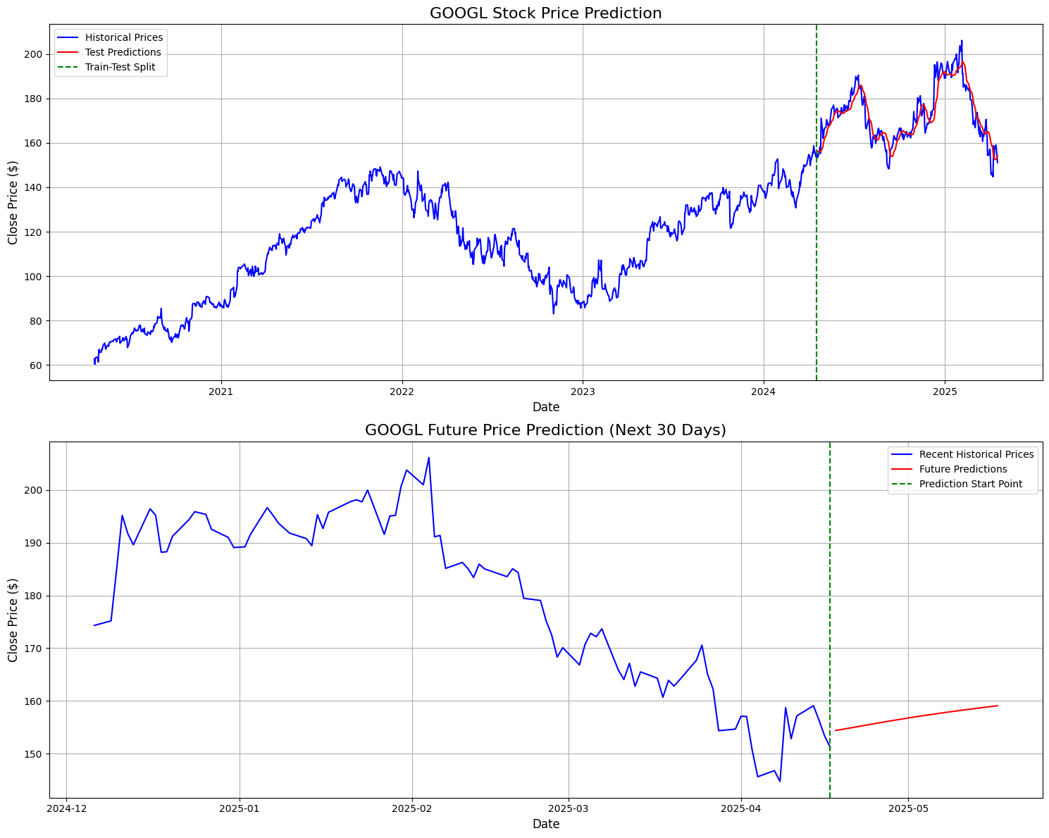
Evaluation and Results
Stacked LSTM (Long Short-Term Memory) Model:

Slide 8
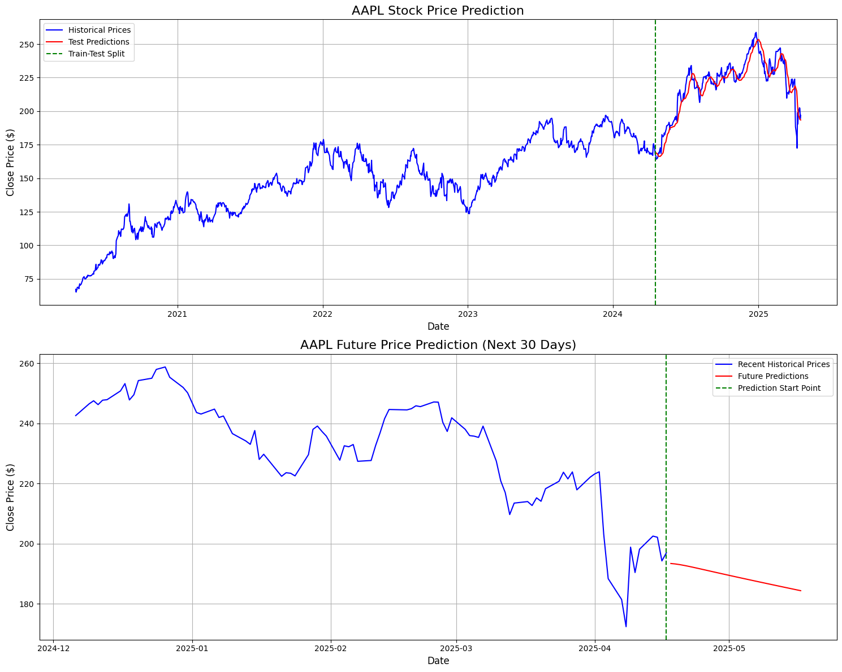
Evaluation and Results

Slide 9
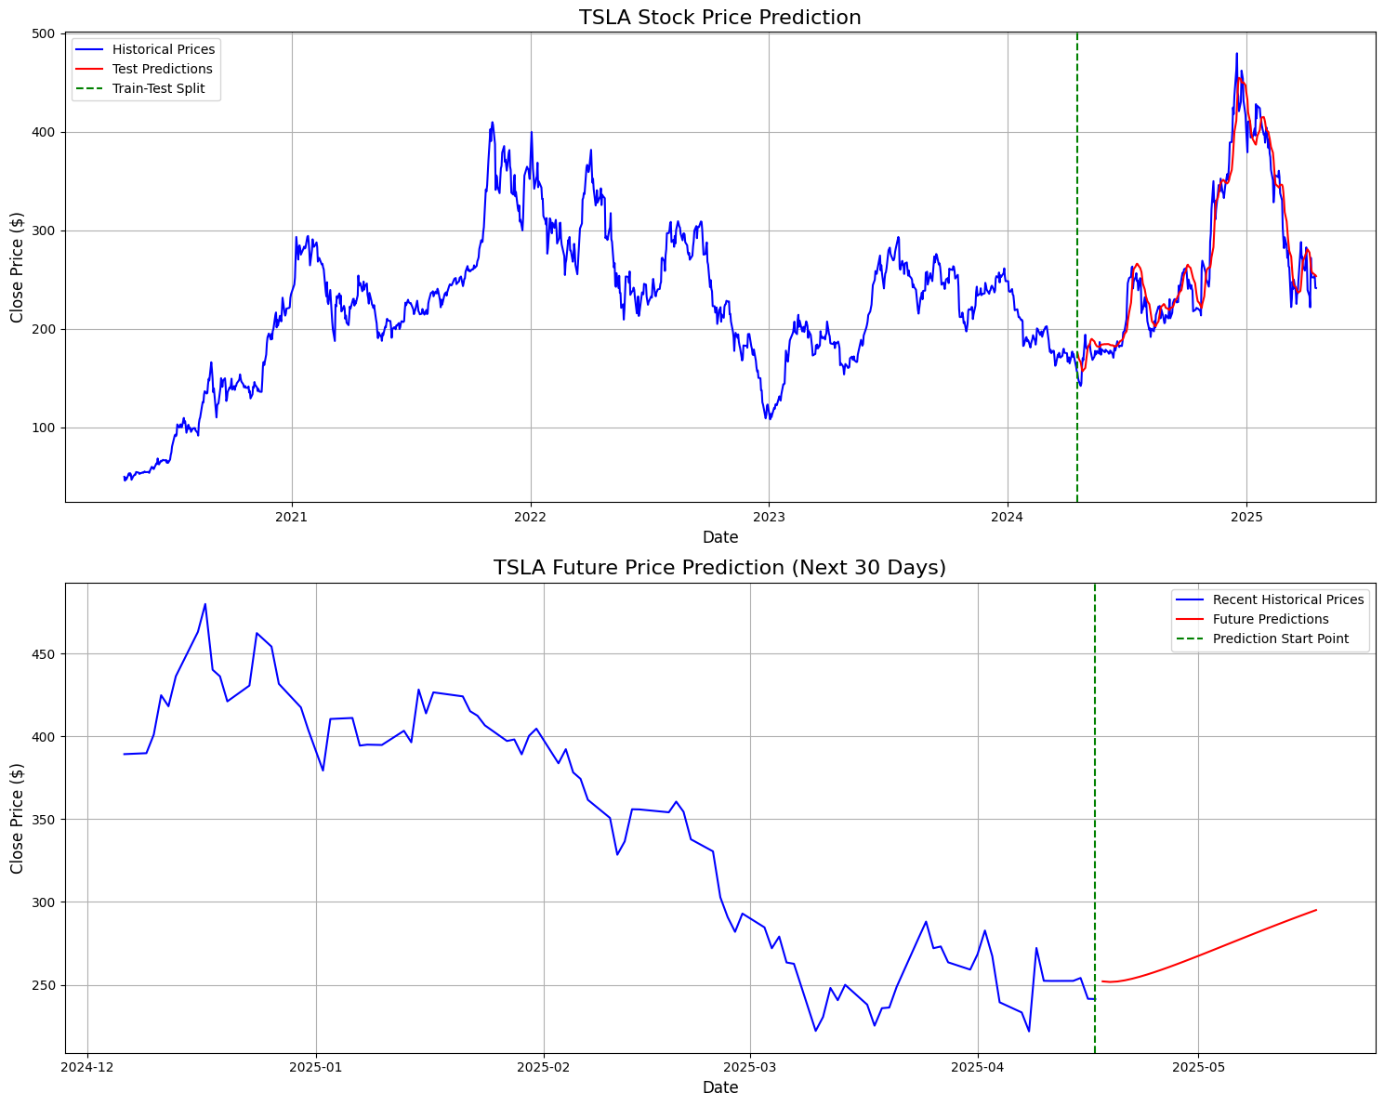
Evaluation and Results

Slide 10
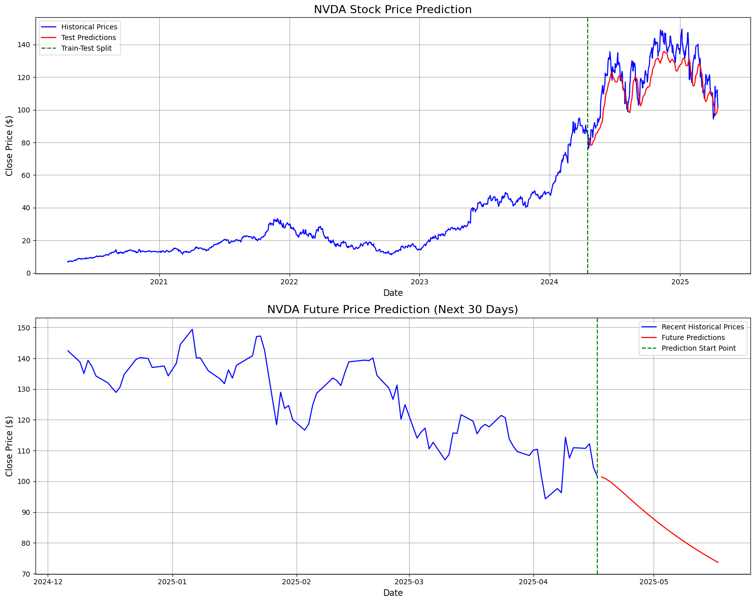
Evaluation and Results

Slide 11
Challenges Faced
Stacked LSTM (Long Short-Term Memory) Model:
Model Overfitting on Volatile Stocks: High fluctuations in stock prices led to the model fitting noise instead of true trends, requiring careful regularization.
Data Preprocessing for Non-Trading Days: Handling gaps due to weekends and market holidays was essential to ensure continuous sequences for the LSTM.
Capturing Sudden Market Events: Unpredictable external factors like earnings announcements or news events were not directly encoded in the data, affecting prediction accuracy.
Balancing Between Model Complexity and Training Time: Deeper LSTM architectures improved learning but significantly increased training time, demanding trade-offs for efficiency.

Slide 12
Future Work
Sentiment-Aware Prediction: Integration of sentiment analysis from financial news articles and social media to enhance model decision-making. By correlating public sentiment with stock price movements, the model can capture broader market behavior beyond numerical data.
Bidirectional LSTM Enhancement: Incorporation of Bidirectional LSTM (BiLSTM) layers to improve sequence learning. This would allow the model to consider both past and future context in a time series window, enhancing prediction accuracy.
Technical Indicator Fusion: Augmenting input features with popular technical indicators such as RSI (Relative Strength Index) and MACD (Moving Average Convergence Divergence). These domain-specific signals can guide the model toward better trend identification and entry/exit predictions.
Real-Time Forecasting Dashboard: Development of an interactive, real-time stock prediction interface. The dashboard would display current predictions, trend graphs, and key metrics, providing users with actionable insights and model interpretability on-the-fly.

Slide 13
Conclusion
In this work, we explored stock price forecasting through the lens of deep learning, using Long Short-Term Memory (LSTM) networks tailored for time-series data. By leveraging sequences of historical stock prices, the LSTM model effectively captured temporal dependencies, demonstrating strong predictive capabilities on real-world financial datasets.
The project highlighted the importance of data preprocessing, model tuning, and sequential validation strategies in time-series forecasting. Through structured evaluation and visualization, we validated the LSTM’s potential as a core predictive model in financial analytics.
Looking ahead, this work establishes a strong foundation for advanced forecasting systems. Future directions include the integration of sentiment analysis, technical indicators, and Bidirectional LSTMs, as well as the development of real-time prediction dashboards. These enhancements promise more accurate, interpretable, and actionable insights in high-stakes financial environments.

